Slide 1

Unlocking the Truth to God’s Holy Land

Slide 2
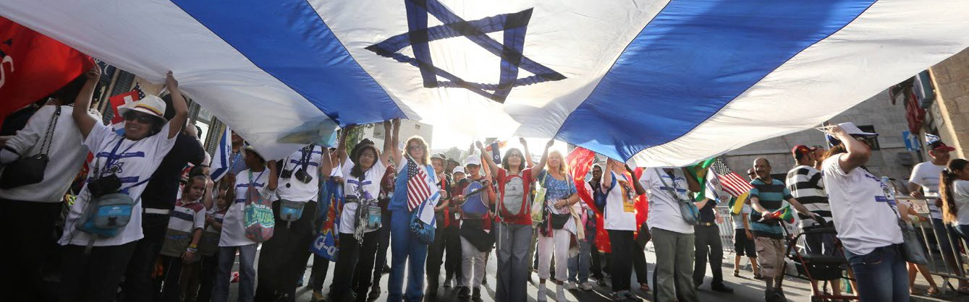

Why Israel? Why now?
The year 2018 will be an important and historic milestone for Israel, as she celebrates her 70th birthday on April 19. Nations rise and fall, as the Bible tells us, but never before in human history has a nation been destroyed, her people scattered, and then reborn — not once, but twice!

Slide 3
Why Israel? Why now?
The year 2018 will be an important and historic milestone for Israel, as she celebrates her 70th birthday on April 19. Nations rise and fall, as the Bible tells us, but never before in human history has a nation been destroyed, her people scattered, and then reborn — not once, but twice!
Though greatly outnumbered, Israel declared her independence in 1948
— a reminder to the world that God still works miracles on behalf of His chosen nation and His beloved children.
Seventy years later, prophecy continues to be fulfilled as God is regathering His people to their biblical homeland.

Slide 4
Why Israel? Why now?
The year 2018 will be an important and historic milestone for Israel, as she celebrates her 70th birthday on April 19. Nations rise and fall, as the Bible tells us, but never before in human history has a nation been destroyed, her people scattered, and then reborn — not once, but twice!
Though greatly outnumbered, Israel declared her independence in 1948
— a reminder to the world that God still works miracles on behalf of His chosen nation and His beloved children.
Seventy years later, prophecy continues to be fulfilled as God is regathering His people to their biblical homeland.
To mark this momentous occasion and to help educate Christians about God’s special bond with Israel and the Jewish people, Rabbi Yechiel Eckstein, founder and President of the International Fellowship of Christians and Jews of Canada¸ has created a special teaching series for churches,
Keys to I.S.R.A.E.L.

Slide 5



What is Keys to I.S.R.A.E.L.?
This six-week program explores six key principles underlying God’s covenantal relationship with His Holy Land and with His chosen people, the Jews, using the acrostic I.S.R.A.E.L.

Slide 6
What is Keys to I.S.R.A.E.L.?
This six-week program explores six key principles underlying God’s covenantal relationship with His Holy Land and with His chosen people, the Jews, using the acrostic I.S.R.A.E.L.
What are the six key principles? I - Important to God (Genesis 12:3)
S - State of Israel (Leviticus 20:24)
R - Righteous Giving (Deuteronomy 15:11)
A - Aliyah — immigration to Israel (Deuteronomy 30:4)
E - Educate yourself and others about Israel (Psalm 25:5)
L - Love your neighbour (Leviticus 19:18)

Slide 7
What is Keys to I.S.R.A.E.L.?
This six-week program explores six key principles underlying God’s covenantal relationship with His Holy Land and with His chosen people, the Jews, using the acrostic I.S.R.A.E.L.
What are the six key principles? I - Important to God (Genesis 12:3)
S - State of Israel (Leviticus 20:24)
R - Righteous Giving (Deuteronomy 15:11)
A - Aliyah — immigration to Israel (Deuteronomy 30:4)
E - Educate yourself and others about Israel (Psalm 25:5)
L - Love your neighbour (Leviticus 19:18)
What’s included in the Church Kit?
Six complete sermon guides
Six Adult Study Guides
Six Children’s Lessons
Video teachings for both adults and children
Promotion materials for your church
Devotions tied to the Keys to I.S.R.A.E.L. principles
All materials are available online.

Slide 8
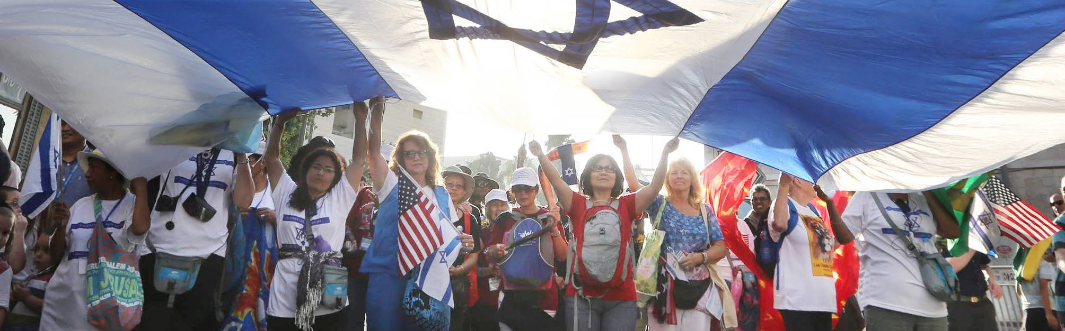
How can I get involved?
Keys to I.S.R.A.E.L. can be a one-day Sunday celebration, OR a six-week campaign, either leading up to Israel Independence Day on April 19, or six weeks after.
It’s up to you and what best fits your congregations’ needs and schedule.

Slide 9
How can I get involved?
Keys to I.S.R.A.E.L. can be a one-day Sunday celebration, OR a six-week campaign, either leading up to Israel Independence Day on April 19, or six weeks after.
It’s up to you and what best fits your congregations’ needs and schedule.
How can I get church kit materials?
Sign up today at www.ifcj.ca/keystoIsrael
for information on getting church kit materials.
Visit holylandmoments.ca to receive devotions right to your inbox.

Slide 10
How can I get involved?
Keys to I.S.R.A.E.L. can be a one-day Sunday celebration, OR a six-week campaign, either leading up to Israel Independence Day on April 19, or six weeks after.
It’s up to you and what best fits your congregations’ needs and schedule.
How can I get church kit materials?
Sign up today at www.ifcj.ca/ keystoIsrael for information on getting church kit materials.
Visit holylandmoments.ca to receive devotions right to your inbox.
How can I support Israel now? Here are three ways you and your church can get involved:
Pray for Israel and her people
Educate yourself and your congregation
about God’s special land and His chosen people with our Keys to I.S.R.A.E.L. teaching series
Take a love offering on Sunday, April 15, to help support The Fellowship’s lifesaving ministries helping needy Jews in Israel

